Slide 1
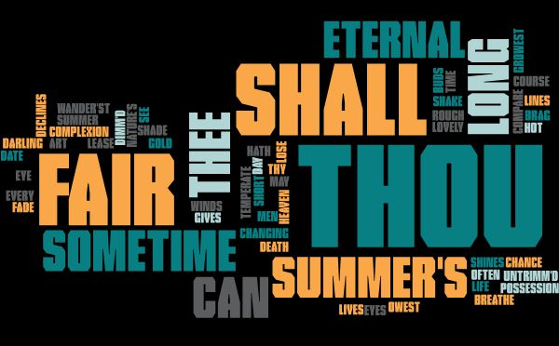
Shall I compare thee to a summer‘s day? Thou art more lovely and more temperate: Rough winds do shake the darling buds of May, And summer’s lease hath all too short a date: Sometime too hot the eye of heaven shines, And often is his 片子女 dimm'd; And every fair from fair sometime declines, By chance or nature's changing course untrimm'd; But thy eternal summer shall not fade Nor lose possession of that fair thou owest; Nor shall Death brag thou wander'st in his shade, When in eternal lines to time thou growest: So long as men can breathe or eyes can see, So long lives this and this gives life to thee.

